Slide 1
TESTING WEB APPLICATIONS

Slide 2
ASSESSING WEB QUALITY
CONTENT EVALUATED AT BOTH SYNTACTIC AND SEMANTIC LEVELS
FUNCTION TESTED TO UNCOVER LACK OF CONFORMANCE TO REQUIREMENTS
STRUCTURE IS ASSESSED TO ENSURE PROPER CONTENT AND FUNCTION ARE DELIVERED
USABILITY IS TESTED TO ENSURE THAT EACH CATEGORY OF USER CAN BE SUPPORTED AS NEW CONTENT OR FUNCTIONALITY IS ADDED
NAVIGABILITY IS TESTED TO ENSURE THAT ALL NAVIGATION SYNTAX AND SEMANTICS ARE EXERCISED
TESTING WEB APPLICATIONS PRAKASH.J PSG COLLEGE OF TECHNOLOGY

Slide 3
ASSESSING WEB QUALITY
PERFORMANCE IS TESTED UNDER A VARIETY OF OPERATING CONDITIONS, CONFIGURATIONS, AND LOADING TO ENSURE A REASONABLE LEVEL OF USER RESPONSE
COMPATIBILITY TESTED BY EXECUTING WEBAPP USING A VARIETY OF CLIENT AND SERVER CONFIGURATIONS
INTEROPERABILITY TESTED TO ENSURE PROPER INTERFACES TO OTHER APPLICATIONS AND DATABASES
SECURITY IS TESTED BY ASSESSING POTENTIAL VULNERABILITIES AND TRYING TO EXPLOIT EACH OF THEM
TESTING WEB APPLICATIONS PRAKASH.J PSG COLLEGE OF TECHNOLOGY

Slide 4
WEB ERROR CONCERNS
MANY TYPES OF WEBAPP TESTS UNCOVER PROBLEMS EVIDENCED ON THE CLIENT SIDE USING AN SPECIFIC INTERFACE (E.G. MAY BE AN ERROR SYMPTOM, NOT THE ERROR ITSELF)
IT MAY BE DIFFICULT TO REPRODUCE ERRORS OUTSIDE OF THE ENVIRONMENT IN WHICH THE ERROR WAS ORIGINALLY ENCOUNTERED
MANY ERRORS CAN BE TRACED TO THE WEBAPP CONFIGURATION, INCORRECT DESIGN, OR IMPROPER HTML
IT IS HARD TO DETERMINE WHETHER ERRORS ARE CAUSED BY PROBLEMS WITH THE SERVER, THE CLIENT, OR THE NETWORK ITSELF
SOME ERRORS ARE ATTRIBUTABLE TO PROBLEMS IN THE STATIC OPERATING ENVIRONMENT AND SOME ARE ATTRIBUTABLE TO THE DYNAMIC OPERATING ENVIRONMENT
TESTING WEB APPLICATIONS PRAKASH.J PSG COLLEGE OF TECHNOLOGY

Slide 5
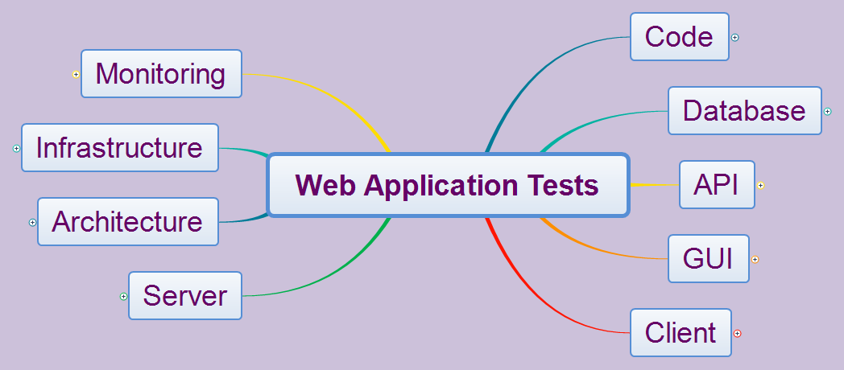

Slide 6
TESTING WEB APPS
WEBAPP CONTENT MODEL IS REVIEWED TO UNCOVER ERRORS.
INTERFACE MODEL IS REVIEWED TO ENSURE ALL USE-CASES ARE ACCOMMODATED.
DESIGN MODEL FOR WEBAPP IS REVIEWED TO UNCOVER NAVIGATION ERRORS.
USER INTERFACE IS TESTED TO UNCOVER PRESENTATION ERRORS AND/OR NAVIGATION MECHANICS PROBLEMS.
SELECTED FUNCTIONAL COMPONENTS ARE UNIT TESTED.
TESTING WEB APPLICATIONS PRAKASH.J PSG COLLEGE OF TECHNOLOGY

Slide 7
TESTING WEB APPS
NAVIGATION THROUGHOUT THE ARCHITECTURE IS TESTED.
WEBAPP IS IMPLEMENTED IN A VARIETY OF DIFFERENT ENVIRONMENTAL CONFIGURATIONS AND THE COMPATIBILITY OF WEBAPP WITH EACH IS ASSESSED.
SECURITY TESTS ARE CONDUCTED.
PERFORMANCE TESTS ARE CONDUCTED.
TESTING WEB APPLICATIONS PRAKASH.J PSG COLLEGE OF TECHNOLOGY

Slide 8
TESTING WEB APPS
WEBAPP IS TESTED BY A MONITORED GROUP OF SELECTED END-USERS LOOKING FOR
CONTENT ERRORS
NAVIGATION ERRORS
USABILITY CONCERNS
COMPATIBILITY ISSUES
PERFORMANCE
TESTING WEB APPLICATIONS PRAKASH.J PSG COLLEGE OF TECHNOLOGY

Slide 9
WEB APP TESTING PROCESS
CONTENT TESTING
TRIES TO UNCOVER CONTENT ERRORS
INTERFACE TESTING
EXERCISES INTERACTION MECHANISMS AND VALIDATES AESTHETIC ASPECTS OF UI
NAVIGATION TESTING
USE-CASES BASIS FOR DESIGN OF TEST CASES THAT EXERCISE EACH USAGE SCENARIOS AGAINST THE NAVIGATION DESIGN (INTEGRATION TESTING)
COMPONENT TESTING
EXERCISES THE WEBAPP CONTENT AND FUNCTIONAL UNITS (INTEGRATION TESTING)
TESTING WEB APPLICATIONS PRAKASH.J PSG COLLEGE OF TECHNOLOGY

Slide 10
WEB APP TESTING PROCESS
CONFIGURATION TESTING
ATTEMPTS TO UNCOVER ERRORS TRACEABLE TO A SPECIFIC CLIENT OR SERVER ENVIRONMENT
CROSS-REFERENCE TABLE IS USEFUL
PERFORMANCE TESTING TO ASSESS
WEBAPP RESPONSE TIME AND RELIABILITY UNDER VARYING SYSTEM LOADS
WHICH WEBAPP COMPONENTS ARE RESPONSIBLE FOR SYSTEM DEGRADATION
HOW PERFORMANCE DEGRADATION IMPACTS OVERALL WEBAPP REQUIREMENTS
SECURITY TESTING
TESTS DESIGNED TO EXPLOIT WEBAPP OR ENVIRONMENT VULNERABILITIES
TESTING WEB APPLICATIONS PRAKASH.J PSG COLLEGE OF TECHNOLOGY

Slide 11
CONTENT TESTING OBJECTIVES
UNCOVER SYNTACTIC ERRORS IN ALL MEDIA
(E.G. TYPOS)
UNCOVER SEMANTIC ERRORS
(E.G. ERRORS IN COMPLETENESS OR ACCURACY)
FIND ERRORS IN ORGANIZATION OR STRUCTURE OF CONTENT PRESENTED TO END-USER
TESTING WEB APPLICATIONS PRAKASH.J PSG COLLEGE OF TECHNOLOGY

Slide 12
DATABASE TESTING
THE ORIGINAL QUERY MUST BE CHECKED TO UNCOVER ERRORS IN TRANSLATING THE USER’S REQUEST TO SQL
PROBLEMS IN COMMUNICATING BETWEEN THE WEBAPP SERVER AND DATABASE SERVER NEED TO BE TESTED.
NEED TO DEMONSTRATE THE VALIDITY OF THE RAW DATA SENT FROM THE DATABASE TO THE WEBAPP AND THE VALIDITY OF THE TRANSFORMATIONS APPLIED TO THE RAW DATA.
NEED TO TEST VALIDITY OF DYNAMIC CONTENT OBJECT FORMATS TRANSMITTED TO THE USER AND THE VALIDITY OF THE TRANSFORMATIONS TO MAKE THE DATA VISIBLE TO THE USER.
TESTING WEB APPLICATIONS PRAKASH.J PSG COLLEGE OF TECHNOLOGY

Slide 13
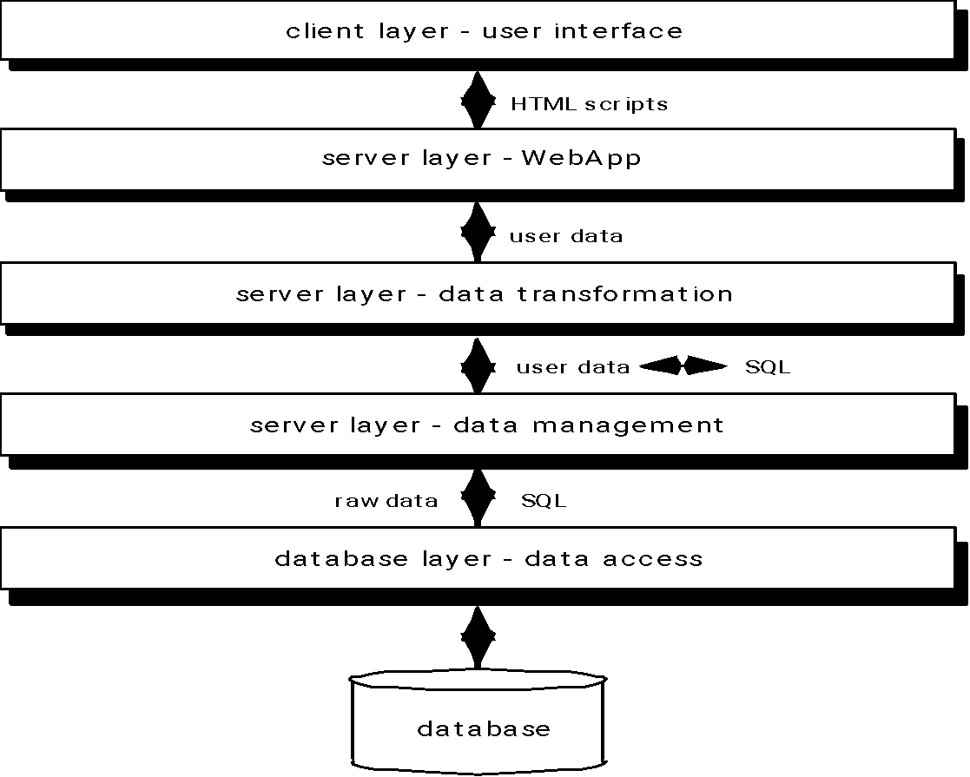
DATABASE TESTING
TESTING WEB APPLICATIONS PRAKASH.J PSG COLLEGE OF TECHNOLOGY

Slide 14
USER INTERFACE TESTING
INTERFACE FEATURES ARE TESTED TO ENSURE THAT DESIGN RULES, AESTHETICS, AND RELATED VISUAL CONTENT IS AVAILABLE FOR USER WITHOUT ERROR.
INDIVIDUAL INTERFACE MECHANISMS ARE TESTED USING UNIT TESTING STRATEGIES.
EACH INTERFACE MECHANISM IS TESTED IN THE CONTEXT OF A USE-CASE OF NAVIGATION SEMANTIC UNIT (E.G. THREAD) FOR A SPECIFIC USER CATEGORY
COMPLETE INTERFACE IS TESTED AGAINST SELECTED USE-CASES AND NAVIGATION SEMANTIC UNIT TO UNCOVER INTERFACE SEMANTIC ERRORS
INTERFACE IS TESTED IN A VARIETY OF ENVIRONMENTS TO ENSURE COMPATIBILITY
TESTING WEB APPLICATIONS PRAKASH.J PSG COLLEGE OF TECHNOLOGY

Slide 15
TESTING INTERFACE MECHANISMS
LINKS
EACH LINK IS LISTED AND TESTED
FORMS
CHECK LABELS, FIELD NAVIGATION, DATA ENTRY, ERROR CHECKING, DATA TRANSMISSION, MEANINGFUL ERROR MESSAGES
CLIENT-SIDE SCRIPTING
BLACK BOX TESTING AND COMPATIBILITY TESTS
DYNAMIC HTML
CORRECTNESS OF GENERATED HTML
COMPATIBILITY TESTS
TESTING WEB APPLICATIONS PRAKASH.J PSG COLLEGE OF TECHNOLOGY

Slide 16
TESTING INTERFACE MECHANISMS
CLIENT-SIDE POP-UP WINDOWS
PROPER SIZE AND PLACEMENT OF POP-UP
WORKING CONTROLS
CONSISTENT WITH APPEARANCE OF WEB PAGE
STREAMING CONTENT (DEMONSTRATE EXISTENCE, ACCURACY, AND CONTROL OVER CONTENT DISPLAY)
TESTING WEB APPLICATIONS PRAKASH.J PSG COLLEGE OF TECHNOLOGY

Slide 17
TESTING INTERFACE MECHANISMS
COOKIES
CHECK THAT SERVER CONSTRUCTS COOKIE CORRECTLY
COOKIE TRANSMITTED CORRECTLY
ENSURE PROPER LEVEL OF PERSISTENCE
CHECK TO SEE WEBAPP ATTACHES THE CORRECT COOKIES
APPLICATION SPECIFIC INTERFACE MECHANISMS
TESTING WEB APPLICATIONS PRAKASH.J PSG COLLEGE OF TECHNOLOGY

Slide 18
USABILITY TESTING
DEFINE SET OF USABILITY TESTING CATEGORIES AND IDENTIFY GOALS FOR EACH
DESIGN TESTS THE WILL ENABLE EACH GOAL TO BE EVALUATED
SELECT PARTICIPANTS TO CONDUCT THE TESTS
INSTRUMENT PARTICIPANTS’ INTERACTIONS WITH THE WEBAPP DURING TESTING
DEVELOP METHOD FOR ASSESSING USABILITY OF THE WEBAPP
TESTING WEB APPLICATIONS PRAKASH.J PSG COLLEGE OF TECHNOLOGY

Slide 19
USABILITY TESTING GOALS
INTERACTIVITY
INTERACTION MECHANISMS ARE EASY TO UNDERSTAND AND USE
LAYOUT
NAVIGATION, CONTENT, AND FUNCTIONS ALLOWS USER TO FIND THEM QUICKLY
READABILITY
CONTENT UNDERSTANDABLE
AESTHETICS
GRAPHIC DESIGN SUPPORTS EASY OF USE
TESTING WEB APPLICATIONS PRAKASH.J PSG COLLEGE OF TECHNOLOGY

Slide 20
USABILITY TESTING GOALS
DISPLAY CHARACTERISTICS
WEBAPP MAKES GOOD USE OF SCREEN SIZE AND RESOLUTION
TIME SENSITIVITY
CONTENT AND FEATURES CAN BE ACQUIRED IN TIMELY MANNER
PERSONALIZATION
ADAPTIVE INTERFACES
ACCESSIBILITY
SPECIAL NEEDS USERS
TESTING WEB APPLICATIONS PRAKASH.J PSG COLLEGE OF TECHNOLOGY

Slide 21
COMPATIBILITY TESTING
GOAL IS TO UNCOVER EXECUTION PROBLEMS THAT CAN BE TRACED TO CONFIGURATION DIFFERENCES
DEFINE A SET OF COMMONLY ENCOUNTERED CLIENT-SIDE COMPUTING CONFIGURATIONS AND THEIR VARIANTS
ORGANIZE THIS INFORMATION (COMPUTING PLATFORM, TYPICAL DISPLAY DEVICES, OPERATING SYSTEM, AVAILABLE BROWSERS, CONNECTION SPEEDS)
DERIVE COMPATIBILITY VALIDATION TEST SUITE FROM EXISTING INTERFACE TESTS, NAVIGATION TESTS, PERFORMANCE TESTS, AND SECURITY TESTS
TESTING WEB APPLICATIONS PRAKASH.J PSG COLLEGE OF TECHNOLOGY

Slide 22
COMPONENT LEVEL TESTING
BLACK BOX AND WHITE BOX TESTING OF EACH WEBAPP FUNCTION
USEFUL TEST CASE DESIGN METHODS
EQUIVALENCE PARTITIONING
BOUNDARY VALUE ANALYSIS (ESP. FORM FIELD VALUES)
PATH TESTING
FORCED ERROR TESTING
TESTING WEB APPLICATIONS PRAKASH.J PSG COLLEGE OF TECHNOLOGY

Slide 23
NAVIGATION TESTING
SYNTACTIC NAVIGATION TESTING
LINKS
REDIRECTS
BOOKMARKS
FRAMES AND FRAMESETS
SITE MAPS
INTERNAL SEARCH ENGINES
TESTING WEB APPLICATIONS PRAKASH.J PSG COLLEGE OF TECHNOLOGY

Slide 24
NAVIGATION TESTING
SEMANTIC NAVIGATION TESTING
NAVIGATION SEMANTIC UNITS ARE DEFINED BY A SET OF PATHWAYS THAT CONNECT NAVIGATION NODES
EACH NSU MUST ALLOWS A USER FROM A DEFINED USER CATEGORY ACHIEVE SPECIFIC REQUIREMENTS DEFINED BY A USE-CASE
TESTING NEEDS TO ENSURE THAT EACH PATH IS EXECUTED IN ITS ENTITY WITHOUT ERROR
EVERY RELEVANT PATH MUST BE TESTED
USER MUST BE GIVEN GUIDANCE TO FOLLOW OR DISCONTINUE EACH PATH BASED ON CURRENT LOCATION IN SITE MAP
TESTING WEB APPLICATIONS PRAKASH.J PSG COLLEGE OF TECHNOLOGY

Slide 25
CONFIGURATION TESTING
CONFIGURATION TESTING SERVER-SIDE
COMPATIBILITY OF WEBAPP WITH SERVER OS
CORRECT FILE AND DIRECTORY CREATION BY WEBAPP
SYSTEM SECURITY MEASURES DO NOT DEGRADE USER SERVICE BY WEBAPP
TESTING WEBAPP WITH DISTRIBUTED SERVER CONFIGURATION
WEBAPP PROPERLY INTEGRATED WITH DATABASE SOFTWARE
CORRECT EXECUTION OF WEBAPP SCRIPTS
EXAMINATION SYSTEM ADMINISTRATION ERRORS FOR IMPACT ON WEBAPP
ON-SITE TESTING OF PROXY SERVERS
TESTING WEB APPLICATIONS PRAKASH.J PSG COLLEGE OF TECHNOLOGY

Slide 26
CONFIGURATION TESTING
CONFIGURATION TESTING CLIENT-SIDE
HARDWARE
OPERATING SYSTEMS
BROWSER SOFTWARE
USER INTERFACE COMPONENTS
PLUG-INS
CONNECTIVITY
TESTING WEB APPLICATIONS PRAKASH.J PSG COLLEGE OF TECHNOLOGY

Slide 27




REFERENCES
TESTING WEB APPLICATIONS PRAKASH.J PSG COLLEGE OF TECHNOLOGY

